Slide 1


Parallel Dot Product
https://github.com/VeriNum/pardotprod
Andrew W. Appel
Princeton
University
August 2022
narration put into writing, May 2025

Slide 2

Abstract
We demonstrate how to use the Verified Software Toolchain
to prove correctness of a parallel program that uses barrier
synchronization implemented with binary semaphores.
That is: master thread breaks the job into T separate tasks, hands off T-1 tasks
to other threads (that are already waiting for them) by releasing per-thread semaphores. Then the master works on one task, then waits on T-1 semaphores
for all the other threads to finish their task.
As an example, we demonstrate parallel dot product. But the work-splitting
API is quite general. It would easily apply to more useful parallel “clients” such as blocked matrix multiply or other algorithms that can use barrier synchronization.

Slide 3
Part 1: The client program and API
In part 1 we don’t use formal methods at all. We just present the C program that we intend to prove correct. The program is divided into
a parallelism API (for handling work that’s split into T tasks) and
an application “client” program that uses the API (in this case, parallel dot-product).

Slide 4
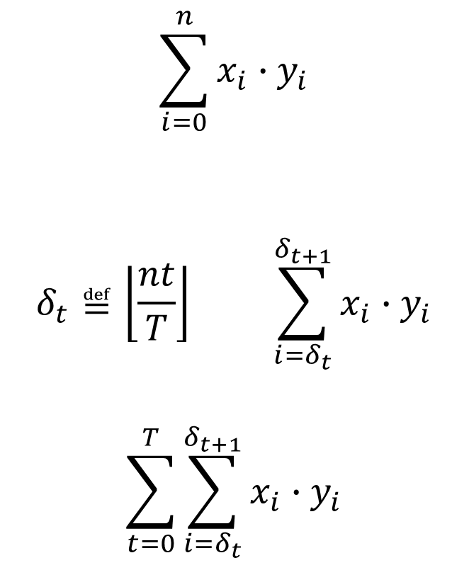
Simple Task Parallelism
All ranges are [lo,hi)
Have a function to compute on big data
Have T processors
Divide computation into T subfunctions (compute in parallel)
Combine subresults together
$$\sum_{i=0}^{n}{x_{i}{∙y}_{i}}$$
$$δ_{t}≝\left\lfloor \frac{nt}{T}\right\rfloor \sum_{i=δ_{t}}^{δ_{t+1}}{x_{i}{∙y}_{i}}$$
$$\sum_{t=0}^{T}{\sum_{i=δ_{t}}^{δ_{t+1}}{x_{i}{∙y}_{i}}}$$

Slide 5
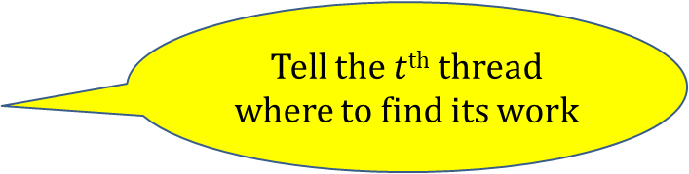
API for work-splitting
parsplit.h
Start T-1 threads
(plus parent makes T)
struct task *make_tasks (unsigned T);
void initialize_task (struct task *tasks,
unsigned t,
void (*f)(void *),
void *closure);
void do_tasks (struct task *tasks, unsigned T);
Tell the $t$^{th} thread where to find its work
Run all the threads on their work
(can do this again and again)
What’s in a struct task is the private information of the task-scheduling
system (parsplit.c) but you can imagine it contains a couple of semaphores, among other things.
The client decides what operation is to be performed in a task, and passes that into initialize_task as the function-parameter f accompanied by supplementary client-side information called closure. The client will call initialize_task T times, with t ranging from 0 to T-1, presumably with different closure values for each one.

Slide 6
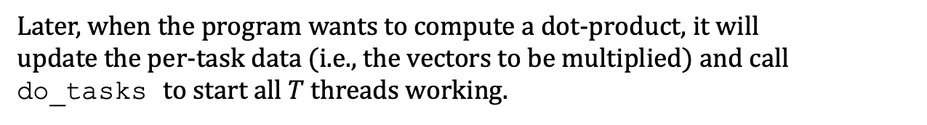
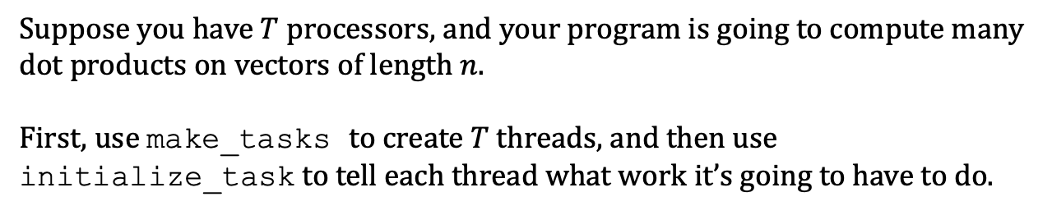
Scenario
Suppose you have $T$ processors, and your program is going to compute many dot products on vectors of length $n$.
First, use make_tasks to create $T$ threads, and then use initialize_task to tell each thread what work it’s going to have to do.
void make_dotprod_tasks(unsigned T) {
unsigned t;
tasks = make_tasks(T);
. . . /* more to come */ . . .
for (t=0; t<T; t++)
initialize_task(tasks, t, ... /* more to come */ ... );
}
Later, when the program wants to compute a dot-product, it will
update the per-task data (i.e., the vectors to be multiplied) and call do_tasks to start all $T$ threads working.

Slide 7

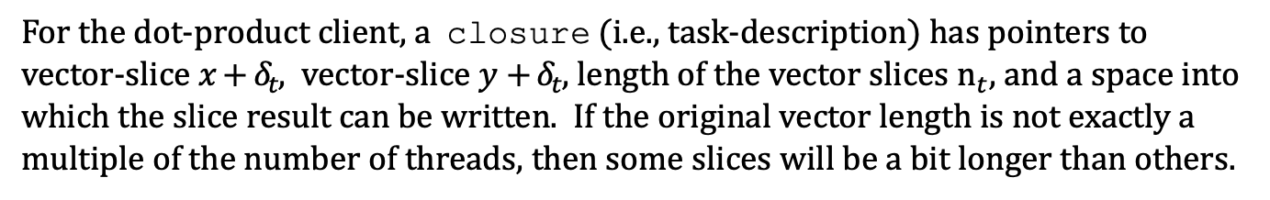










Example: n=10, T=4
struct task *make_tasks (unsigned T);
void initialize_task (struct task *tasks, unsigned t, void (*f)(void *), void *closure);
void do_tasks (struct task *tasks, unsigned T);
$$δ_{0}$$
$$x$$
$$y$$
$$δ_{t}≝nt/T$$
$$n_{t}≝δ_{t+1}−δ_{t}$$
0
$$δ_{1}$$
one slice
of work
$$δ_{2}$$
$$δ_{3}$$
$$x+δ_{t}$$
$$y+δ_{t}$$
$$n_{t}$$
result
$$δ_{4}$$
10
Task description (struct dotprod_task)
For the dot-product client, a closure (i.e., task-description) has pointers to vector-slice $x+δ_{t}$, vector-slice $y+δ_{t}$, length of the vector slices $n_{t}$, and a space into which the slice result can be written. If the original vector length is not exactly a multiple of the number of threads, then some slices will be a bit longer than others.

Slide 8

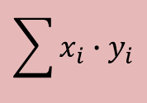



Application-specific subtask function
struct task *make_tasks (unsigned T);
void initialize_task (struct task *tasks, unsigned t, void (*f)(void *), void *closure);
void do_tasks (struct task *tasks, unsigned T);
$$x$$
$$y$$
void dotprod_worker(void *closure) {
struct dotprod_task *w = closure;
double result=0.0;
unsigned n = w->n;
double *vec1= w->vec1, *vec2= w->vec2;
unsigned i;
for (i=0; i<n; i++)
result += vec1[i]*vec2[i];
w->result=result;
}
$$\sum{x_{i}{∙y}_{i}}$$
$$x+δ_{t}$$
$$y+δ_{t}$$
$$n_{t}$$
result
The dotprod_worker is given a pointer to a closure and computes the slice dot product for that task-description. The formal parameter has type void* instead of struct dotprod_task * because the task-scheduler (parsplit.c, parsplit.h) must be general enough that it doesn’t even know the type of the task-description. Hence the assignment from closure to w in the first line of the function body.

Slide 9
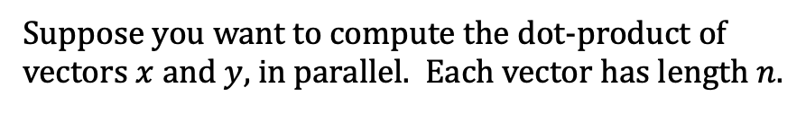
How the client uses the API
struct task *make_tasks (unsigned T);
void initialize_task (struct task *tasks, unsigned t, void (*f)(void *), void *closure);
void do_tasks (struct task *tasks, unsigned T);
$$x$$
$$y$$
Suppose you want to compute the dot-product of
vectors $x$ and $y$, in parallel. Each vector has length $n$.
double dotprod(double *vec1, double *vec2, unsigned n) {
}

Slide 10





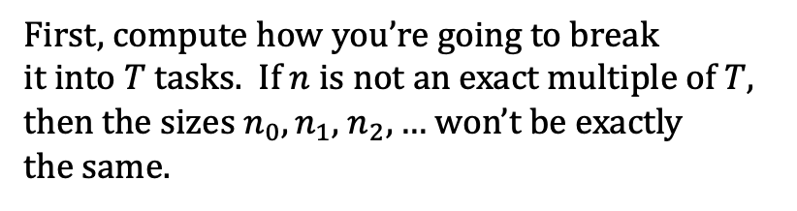

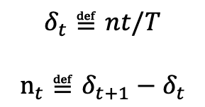








Creating the task-descriptions
struct task *make_tasks (unsigned T);
void initialize_task (struct task *tasks, unsigned t, void (*f)(void *), void *closure);
void do_tasks (struct task *tasks, unsigned T);
dtasks
First, compute how you’re going to break
it into $T$ tasks. If $n$ is not an exact multiple of $T$, then the sizes $n_{0},n_{1},$ $n_{2},…$ won’t be exactly
the same.
$$x$$
$$y$$
$$x+δ_{0}$$
$$y+δ_{0}$$
$$n_{0}$$
result
$$x+δ_{1}$$
$$y+δ_{1}$$
$$δ_{t}≝nt/T$$
$$n_{t}≝δ_{t+1}−δ_{t}$$
$$n_{1}$$
result
$$x+δ_{2}$$
$$y+δ_{2}$$
$$n_{2}$$
result
$$x+δ_{3}$$
$$y+δ_{3}$$
double dotprod(double *vec1, double *vec2, unsigned n) {
for (delta=0, t=0; t<T; t++) {
dtasks[t].vec1=vec1+delta;
dtasks[t].vec2=vec2+delta;
delta_next = (t+1)*n/T;
dtasks[t].n= delta_next-delta;
delta=delta_next;
}
. . .
}
$$n_{3}$$
result
(For how & when the dtasks array was created, wait a couple of slides. Here we’re just filling it in. )

Slide 11
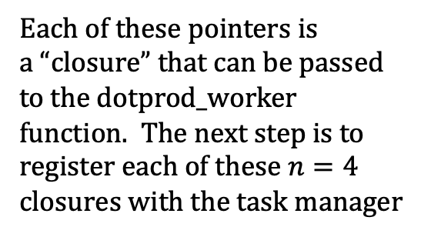
dotprod_worker
struct task *make_tasks (unsigned T);
void initialize_task (struct task *tasks, unsigned t, void (*f)(void *), void *closure);
void do_tasks (struct task *tasks, unsigned T);
dtasks
$$x+δ_{0}$$
$$y+δ_{0}$$
$$x$$
$$y$$
$$n_{0}$$
result
$$x+δ_{1}$$
$$y+δ_{1}$$
Each of these pointers is
a “closure” that can be passed
to the dotprod_worker
function. The next step is to
register each of these $n=4$
closures with the task manager
$$n_{1}$$
result
$$x+δ_{2}$$
$$y+δ_{2}$$
$$n_{2}$$
result
$$x+δ_{3}$$
$$y+δ_{3}$$
$$n_{3}$$
result

Slide 12
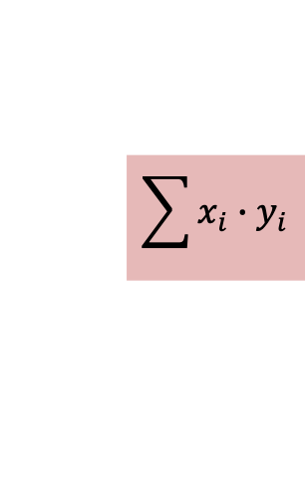
do_tasks( )
struct task *make_tasks (unsigned T);
void initialize_task (struct task *tasks, unsigned t, void (*f)(void *), void *closure);
void do_tasks (struct task *tasks, unsigned T);
$$\sum{x_{i}{∙y}_{i}}$$
dtasks
tasks
$$x$$
$$y$$
$$x+δ_{0}$$
$$y+δ_{0}$$
$$n_{0}$$
result
$$x+δ_{1}$$
$$y+δ_{1}$$
$$n_{1}$$
result
$$x+δ_{2}$$
$$y+δ_{2}$$
The tasks array has the
scheduler-side information
about each task;
that includes,
as shown here, pointer to what function f to execute and the specific closure information for each task.
$$n_{2}$$
result
$$x+δ_{3}$$
$$y+δ_{3}$$
$$n_{3}$$
result

Slide 13










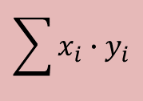


make_tasks( ), initialize_task( )
struct task *make_tasks (unsigned T);
void initialize_task (struct task *tasks, unsigned t, void (*f)(void *), void *closure);
void do_tasks (struct task *tasks, unsigned T);
$$\sum{x_{i}{∙y}_{i}}$$
dtasks
tasks
$$x$$
$$y$$
$$x+δ_{0}$$
$$y+δ_{0}$$
$$n_{0}$$
result
$$x+δ_{1}$$
$$y+δ_{1}$$
$$n_{1}$$
result
$$x+δ_{2}$$
$$y+δ_{2}$$
$$n_{2}$$
result
$$x+δ_{3}$$
$$y+δ_{3}$$
void make_dotprod_tasks(unsigned T) {
unsigned t;
tasks = make_tasks(T);
num_threads=T;
dtasks=(struct dotprod_task *)malloc(T*sizeof(…));
for (t=0; t<T; t++)
initialize_task(tasks, t, dotprod_worker, dtasks+t);
}
$$n_{3}$$
result
And here is the client’s function that creates both the
tasks array and the dtasks array, and fills in the tasks.
num_threads is a client-side
global variable.

Slide 14
do_tasks( )
struct task *make_tasks (unsigned T);
void initialize_task (struct task *tasks, unsigned t, void (*f)(void *), void *closure);
void do_tasks (struct task *tasks, unsigned T);
$$\sum{x_{i}{∙y}_{i}}$$
dtasks
$$x$$
$$y$$
$$x+δ_{0}$$
$$y+δ_{0}$$
$$n_{0}$$
result
$$x+δ_{1}$$
$$y+δ_{1}$$
$$n_{1}$$
result
$$x+δ_{2}$$
$$y+δ_{2}$$
double dotprod(double *vec1, double *vec2, unsigned n) {
for (delta=0, t=0; t<T; t++) {
dtasks[t].vec1=vec1+delta;
dtasks[t].vec2=vec2+delta;
delta_next = (t+1)*n/T;
dtasks[t].n= delta_next-delta;
delta=delta_next;
}
do_tasks(tasks, T);
for (result=0.0, t=0; t<T; t++) result += dtasks[t].result;
return result;
}
$$n_{2}$$
result
$$x+δ_{3}$$
$$y+δ_{3}$$
$$n_{3}$$
result
To compute a dot-product,
update the per-task info (shown previously);
call do_tasks to run the parallel jobs;
collect all the results

Slide 15
That’s the entire dotprod.c client
void dotprod_worker(void *closure) {
struct dotprod_task *w = closure;
double result=0.0;
unsigned n = w->n;
double *vec1= w->vec1, *vec2= w->vec2;
unsigned i;
for (i=0; i<n; i++)
result += vec1[i]*vec2[i];
w->result=result;
}
double dotprod(double *vec1, double *vec2, unsigned n) {
for (delta=0, t=0; t<T; t++) {
dtasks[t].vec1=vec1+delta;
dtasks[t].vec2=vec2+delta;
delta_next = (t+1)*n/T;
dtasks[t].n= delta_next-delta;
delta=delta_next;
}
do_tasks(tasks, T);
for (result=0.0, t=0; t<T; t++) result += dtasks[t].result;
return result;
}
void make_dotprod_tasks(unsigned T) {
unsigned t;
tasks = make_tasks(T);
num_threads=T;
dtasks=(struct dotprod_task *)malloc(T*sizeof(…));
for (t=0; t<T; t++)
initialize_task(tasks, t, dotprod_worker, dtasks+t);
}
struct task *make_tasks (unsigned T);
void initialize_task (struct task *tasks, unsigned t, void (*f)(void *), void *closure);
void do_tasks (struct task *tasks, unsigned T);

Slide 16
Part 2: How the parallelism is implemented
struct task *make_tasks (unsigned T);
void initialize_task (struct task *tasks, unsigned t, void (*f)(void *), void *closure);
void do_tasks (struct task *tasks, unsigned T);
This is the API; how do these functions work?

Slide 17
thread_worker( ), make_tasks( )
struct task *make_tasks (unsigned T);
void initialize_task (struct task *tasks, unsigned t, void (*f)(void *), void *closure);
void do_tasks (struct task *tasks, unsigned T);
tasks
struct task
go
f
done
closure
int thread_worker(void *arg) {
struct task *t = (struct task *)arg;
while (1) {
acquire(t->go);
t->f(t->closure);
release(t->done);
}
}
What runs in each thread is simple:
wait for the go signal,
run the function f on the closure,
send the done signal.
Repeat forever.

Slide 18
thread_worker( ), make_tasks( )
struct task *make_tasks (unsigned T);
void initialize_task (struct task *tasks, unsigned t, void (*f)(void *), void *closure);
void do_tasks (struct task *tasks, unsigned T);
tasks
struct task *make_tasks(unsigned T) {
tasks = malloc(T * sizeof (…));
for (i=1; i<T; i++) {
struct task *t = tasks+i;
t->go = makelock();
t->done = makelock();
spawn(thread_worker, t);
}
return tasks;
}
struct task
go
f
done
closure
int thread_worker(void *arg) {
struct task *t = (struct task *)arg;
while (1) {
acquire(t->go);
t->f(t->closure);
release(t->done);
}
}
All make_tasks does is,
create all the go and done semaphores
spawn all the threads to run thread_worker
(semaphores are created in the locked state, so the first thing all those threads do is block on the acquire).

Slide 19
initialize_task ( )
struct task *make_tasks (unsigned T);
void initialize_task (struct task *tasks, unsigned t, void (*f)(void *), void *closure);
void do_tasks (struct task *tasks, unsigned T);
tasks
go
f
done
closure
void initialize_task (struct task *tasks,
unsigned i,
void (*f)(void *),
void *closure) {
tasks[i].f=f;
tasks[i].closure=closure;
}
After the client calls make_tasks to spawn all the threads, then the client calls initialize_task to fill in the info about the function and closure.

Slide 20
do_tasks ( )
struct task *make_tasks (unsigned T);
void initialize_task (struct task *tasks, unsigned t, void (*f)(void *), void *closure);
void do_tasks (struct task *tasks, unsigned T);
tasks
go
f
done
closure
void do_tasks(struct task *tasks, unsigned T) {
for (i=1; i<T; i++)
release (tasks[i].go);
tasks[0].f(tasks[0].closure);
for (i=1; i<T; i++)
acquire (tasks[i].done);
}
To compute a parallel dot product, the client calls do_tasks which is very simple: send each thread the go signal,
compute task 0 locally, wait for each thread to send the done signal.

Slide 21
That’s the entire parsplit.c
struct task *make_tasks (unsigned T);
void initialize_task (struct task *tasks, unsigned t, void (*f)(void *), void *closure);
void do_tasks (struct task *tasks, unsigned T);
int thread_worker(void *arg) {
struct task *t = (struct task *)arg;
while (1) {
acquire(t->go);
t->f(t->closure);
release(t->done);
}
}
void initialize_task (struct task *tasks,
unsigned i, void (*f)(void *), void *closure) {
tasks[i].f=f;
tasks[i].closure=closure;
}
struct task *make_tasks(unsigned T) {
tasks = malloc(T * sizeof (…));
for (i=1; i<T; i++) {
struct task *t = tasks+i;
t->go = makelock();
t->done = makelock();
spawn(thread_worker, t);
}
return tasks;
}
void do_tasks(struct task *tasks, unsigned T) {
for (i=1; i<T; i++)
release (tasks[i].go);
tasks[0].f(tasks[0].closure);
for (i=1; i<T; i++)
acquire (tasks[i].done);
}

Slide 22
How to prove it
Part 3

Slide 23
Separation Logic
If state
satisfies the
precondition
then it’s safe
to run the
command
and the state
after will satisfy
the postcondition
{Pre} command {Post}
separating
conjunction
P∗Q
P′∗Q

Slide 24
Separation Logic
If state
satisfies the
precondition
then it’s safe
to run the
command
and the state
after will satisfy
the postcondition
{Pre} command {Post}
separating
conjunction
P∗Q
P′∗Q
{ x↦(1,y) ∗ y↦(2,z) }
x.data=3;
{ x↦(3,y) ∗ y↦(2,z) }
x
1
2
z
x
3
2
z
y
y

Slide 25
Heaplets in Separation Logic
x↦(1,y) ∗ y↦(2,z)
A “heaplet” is a model of a
separating conjunct; it’s a
(not necessarily contiguous)
part of memory with a
given footprint (domain)
1
2
z
x
y
x↦(1,y) ∗ y↦(2,z)
The separating
conjunction ∗ is
about the union
of two disjoint
footprints
1
2
z
x
y

Slide 26
Heaplets in Separation Logic
1
2
z
x
y
{ x↦(1,y) ∗ y↦(2,z) }
x.data=3;
{ x↦(3,y) ∗ y↦(2,z) }
We can safely say
that x.data is updated
and y.data is still 2,
because x cannot
be aliased with y
if the precondition
is satisfied
3
2
z
x
y

Slide 27
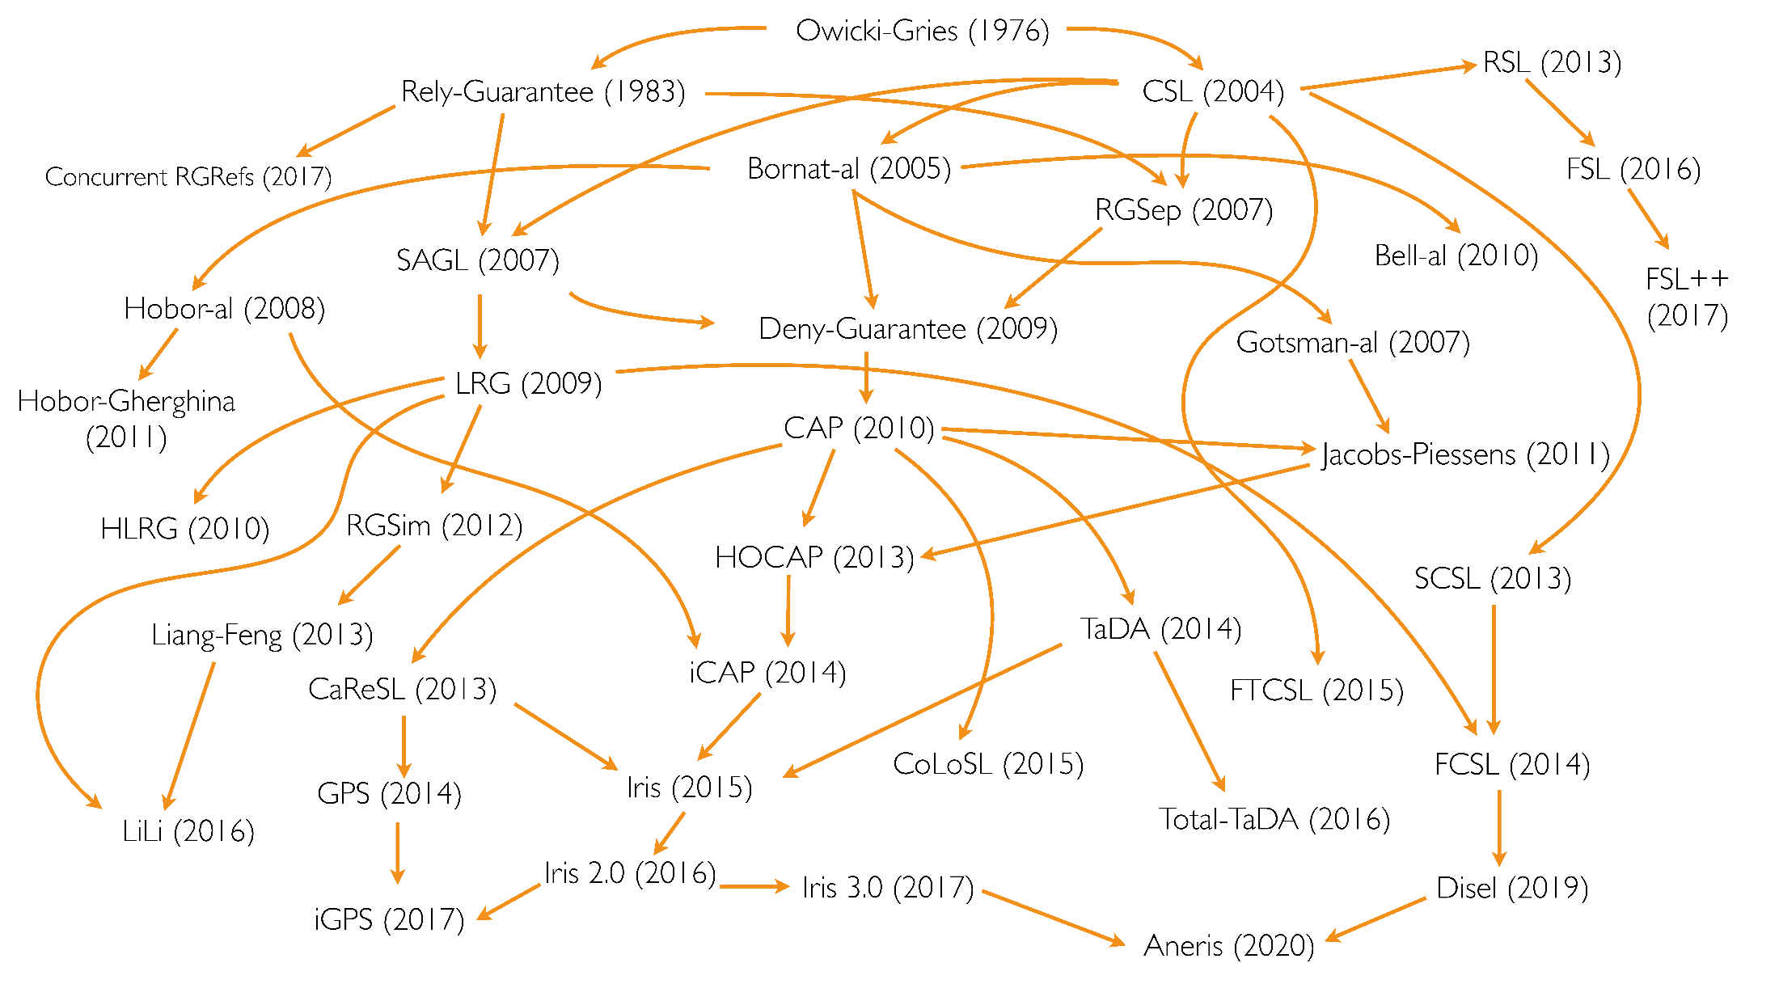
Concurrent Separation Logics
CSL uses separating conjunction to do thread-local reasoning
But there are many flavors of CSL since O’Hearn’s 2004 original
diagram: Ilya Sergey

Slide 28
How to prove it
Some of those CSLs are quite complicated (but very expressive). But our needs here are simple:
Don’t need ghost state
Don’t need partial commutative monoid
Semaphores with “old-fashioned” lock invariants
Permission-splitting
∴ all the theory was in place by 2008!

Slide 29
Concurrent Separation Logics
Oracle Semantics for Concurrent Separation Logic, by Aquinas Hobor, Andrew W. Appel, and Francesco Zappa Nardelli. European Symposium on Programming (ESOP), 2008.

Slide 30
Concurrent Separation Logics
What varieties does VST support, by the way?
Either Hobor-style or Iris-style, your choice
An Iris Instance for Verifying CompCert C Programs, by William Mansky and Ke Du, POPL’24

Slide 31
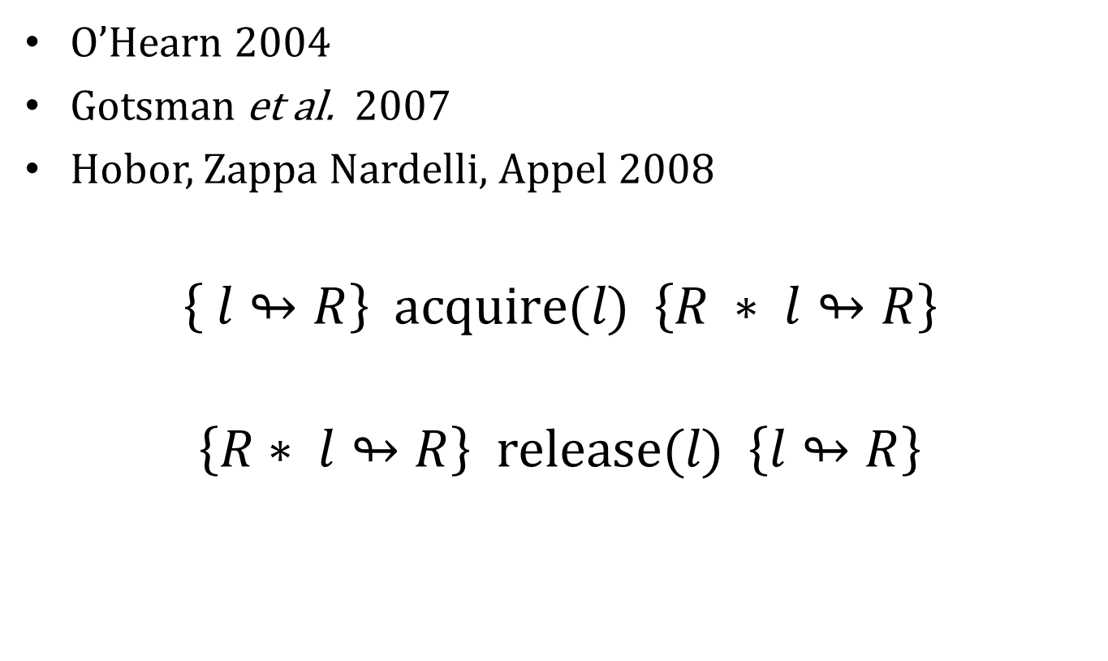
Resource invariants
O’Hearn 2004
Gotsman et al. 2007
Hobor, Zappa Nardelli, Appel 2008
$$\left\{ l↬R\right\} \text{acquire}\text{(}l\text{) } \left\{R ∗ l↬R\right\}$$
$$\left\{R∗ l↬R\right\} \text{release}\text{(}l\text{) } \left\{l↬R\right\}$$
acquire the lock, gain the resource
release the lock,
give up the
resource

Slide 32
Heaplets in Separation Logic
1
2
z
x
y
{ x↦(1,y) ∗ y↦(2,z) ∗ 𝑙↬(∃y. x↦(1,y))}
release(𝑙)
{ y↦(2,z) ∗ 𝑙↬(∃y. x↦(1,y))}
1
2
z
x
y

Slide 33
Heaplets in Separation Logic
this is the resource invariant of the lock
{𝑙↬(∃y. x↦(1,y))}
acquire the lock,
gain the resource
acquire(𝑙)
{ x↦(1,y) ∗ 𝑙↬(∃y. x↦(1,y))}
1
y
x

Slide 34
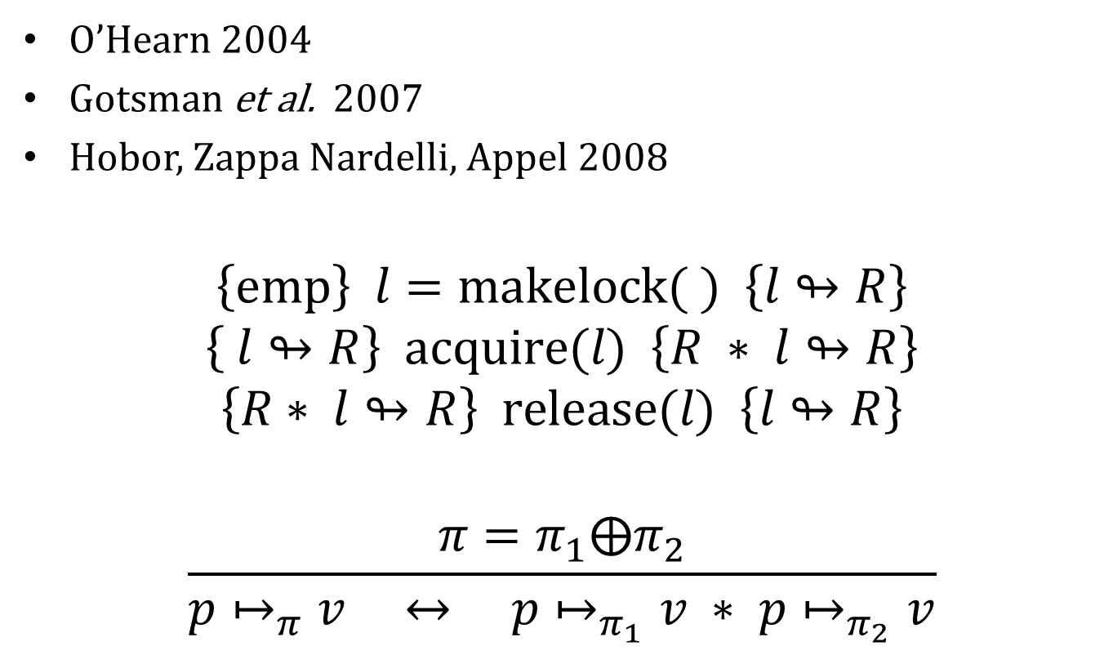
Permission shares
O’Hearn 2004
Gotsman et al. 2007
Hobor, Zappa Nardelli, Appel 2008
$$\left\{\text{emp}\right\} l=\text{makelock}\text{(} \text{) } \left\{l↬R\right\}$$
$$\left\{ l↬R\right\} \text{acquire}\text{(}l\text{) } \left\{R ∗ l↬R\right\}$$
$$\left\{R∗ l↬R\right\} \text{release}\text{(}l\text{) } \left\{l↬R\right\}$$
$$\frac{π=π_{1}⨁π_{2}}{p↦_{π}v ↔ p↦_{π_{1}}v ∗ p↦_{π_{2}}v}$$
split the permission share
into two parts
split the “maps-to” resource into two resources

Slide 35
Resource invariants for parsplit
void do_tasks(struct task *tasks, unsigned T) {
for (i=1; i<T; i++)
release (tasks[i].go);
tasks[0].f(tasks[0].closure);
for (i=1; i<T; i++)
acquire (tasks[i].done);
}
int thread_worker(void *arg) {
struct task *t = (struct task *)arg;
while (1) {
acquire(t->go);
t->f(t->closure);
release(t->done);
}
}
Release the go-lock, thread_worker acquires it and starts working
Release the done-lock, task manager resumes collecting “done” statuses

Slide 36
Resource invariants for parsplit
void do_tasks(struct task *tasks, unsigned T) {
for (i=1; i<T; i++)
release (tasks[i].go);
tasks[0].f(tasks[0].closure);
for (i=1; i<T; i++)
acquire (tasks[i].done);
}
int thread_worker(void *arg) {
struct task *t = (struct task *)arg;
while (1) {
acquire(t->go);
t->f(t->closure);
release(t->done);
}
}
x
y
n
result
Definition task_inv $T q p$≔ $∃f∃clo, (p.\text{f} ↦_{\text{r}}f)∗(p.\text{closure}↦_{\text{r}}clo)∗∃c, P(T,c,q,clo).$
We will use this definition in constructing resource invariants for go and done locks.

Slide 37
Resource invariants for parsplit
void do_tasks(struct task *tasks, unsigned T) {
for (i=1; i<T; i++)
release (tasks[i].go);
tasks[0].f(tasks[0].closure);
for (i=1; i<T; i++)
acquire (tasks[i].done);
}
int thread_worker(void *arg) {
struct task *t = (struct task *)arg;
while (1) {
acquire(t->go);
t->f(t->closure);
release(t->done);
}
}
x
y
n
result
Definition task_inv $T q p$≔ $∃f∃clo, (p.\text{f} ↦_{\text{r}}f)∗(p.\text{closure}↦_{\text{r}}clo)∗∃c, P(T,c,q,clo).$
Argument $p$ is the pointer to the task block (go,done,f,closure)

Slide 38
Resource invariants for parsplit
void do_tasks(struct task *tasks, unsigned T) {
for (i=1; i<T; i++)
release (tasks[i].go);
tasks[0].f(tasks[0].closure);
for (i=1; i<T; i++)
acquire (tasks[i].done);
}
int thread_worker(void *arg) {
struct task *t = (struct task *)arg;
while (1) {
acquire(t->go);
t->f(t->closure);
release(t->done);
}
}
x
y
n
result
Definition task_inv $T q p$≔ $∃f∃clo, (p.\text{f} ↦_{\text{r}}f)∗(p.\text{closure}↦_{\text{r}}clo)∗∃c, P(T,c,q,clo).$
(existentially quantified) clo is the pointer to the dtask descriptor

Slide 39
Resource invariants for parsplit
void do_tasks(struct task *tasks, unsigned T) {
for (i=1; i<T; i++)
release (tasks[i].go);
tasks[0].f(tasks[0].closure);
for (i=1; i<T; i++)
acquire (tasks[i].done);
}
int thread_worker(void *arg) {
struct task *t = (struct task *)arg;
while (1) {
acquire(t->go);
t->f(t->closure);
release(t->done);
}
}
x
y
n
result
Definition task_inv $T q p$≔ $∃f∃clo, (p.\text{f} ↦_{\text{r}}f)∗(p.\text{closure}↦_{\text{r}}clo)∗∃c, P(T,c,q,clo).$
P is the (client-specific) task predicate (describing this slice of the $x,y$ vectors)

Slide 40


Client-specific task predicate
P is the client-specific (in this case, dot-product) predicate describing
the state of the client task description
the $i$th dtask + the $i$th vector slices
$$P(T,c,q,clo).$$
x
y
n
This is the state when the go lock is released
x
y
n
x⋅y
This is the state when the done lock is released
Definition task_inv $T q p$≔ $∃f∃clo, (p.\text{f} ↦_{\text{r}}f)∗(p.\text{closure}↦_{\text{r}}clo)∗∃c, P(T,c,q,clo).$

Slide 41


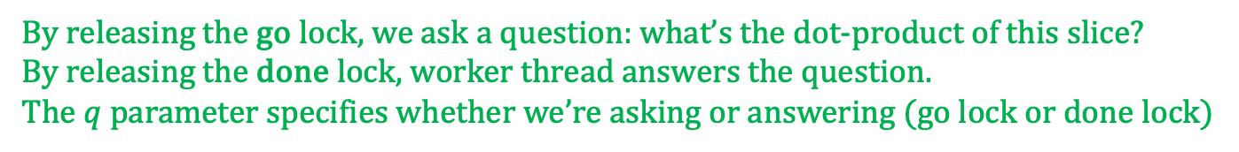

Questions and answers
By releasing the go lock, we ask a question: what’s the dot-product of this slice?
By releasing the done lock, worker thread answers the question.
The $q$ parameter specifies whether we’re asking or answering (go lock or done lock)
$$P(T,c,q,clo).$$
$q$=ASK
x
y
n
$q$=ANSWER
x
y
n
x⋅y
Definition task_inv $T q p$≔ $∃f∃clo, (p.\text{f} ↦_{\text{r}}f)∗(p.\text{closure}↦_{\text{r}}clo)∗∃c, P(T,c,q,clo).$

Slide 42
Resource invariants
do_tasks
for (i=1; i<T; i++)
release (tasks[i].go);
for (i=1; i<T; i++)
acquire (tasks[i].done);
}
thread_worker
while (1) {
acquire(t->go);
t->f(t->closure);
release(t->done);
}
ASK
x
y
release(go)
acquire(go)
n
ANSWER
x
y
acquire(done)
release(done)
n
x⋅y

Slide 43


What question did I ask?
Client
Server
ASK
x
y
n
ANSWER
x
y
n
x⋅y
Client
Server
ASK
x
y
n
ANSWER
x7
y7
n
x7y7
We must prevent the worker thread from changing the question,
while permitting it to fill in the answer!

Slide 44

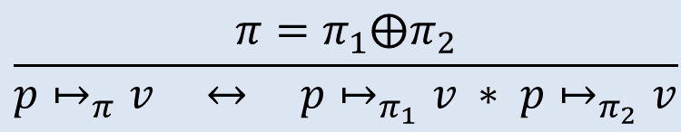


Splitting shares
$$\frac{π=π_{1}⨁π_{2}}{p↦_{π}v ↔ p↦_{π_{1}}v ∗ p↦_{π_{2}}v}$$
Client
Server
x
y
=
x
y
∗
x
y
n
$$⊤$$
n
$$π_{1}$$
n
$$π_{2}$$
read/write
read/write
read-only
A “writable” share may be split into two “readable” shares.

Slide 45


Splitting shares
$$\frac{π=π_{1}⨁π_{2}}{p↦_{π}v ↔ p↦_{π_{1}}v ∗ p↦_{π_{2}}v}$$
Client
Server
x
y
=
x
y
∗
x
y
n
$$⊤$$
n
n
REMEMBER
ASK
x
y
ASK
n
$$π_{2}$$
x
y
ANSWER
n
x⋅y
$$π_{2}$$
Split a “Top” share into a “Remember” share (readable x,y,n; no-access result)
and an “Ask/Answer” share (readable x,y,n; writable result)

Slide 46


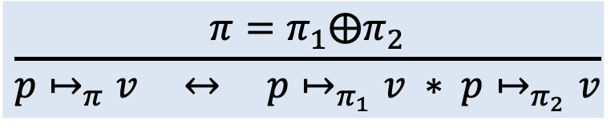



Splitting shares
$$\frac{π=π_{1}⨁π_{2}}{p↦_{π}v ↔ p↦_{π_{1}}v ∗ p↦_{π_{2}}v}$$
Client
Server
x
y
=
x
y
∗
x
y
n
$$⊤$$
n
n
REMEMBER
ASK
x
y
ASK
n
$$π_{2}$$
x
y
ANSWER
n
x⋅y
$$π_{2}$$
Fact: If you join two readable
shares, the values
must be the same!
So we make sure the answer corresponds to the original question.
x
y
∗
x’
y’
⊢ x=x’ ∧ y=y’
n
$$π_{1}$$
n
x’⋅y’
$$π_{2}$$

Slide 47
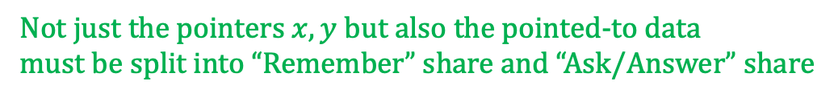

Must also split shares of . . .
x
y
n
REMEMBER
x
y
ASK
n
$$π_{2}$$
Not just the pointers $x,y$ but also the pointed-to data
must be split into “Remember” share and “Ask/Answer” share

Slide 48


The functional model
Floating-point add is not associative, so cannot prove
$$\sum_{i=0}^{n}{x_{i}{∙y}_{i}}$$
Instead we prove
$$\sum_{t=0}^{T}{\sum_{i=δ_{t}}^{δ_{t+1}}{x_{i}{∙y}_{i}}}$$
and let the upper-layer proofs worry about accuracy of associativity

Slide 49
Q.E.D.
That’s my proof!
In Coq it’s a bit more verbose.

Slide 50
But does the program work?
$ time ./dotprod 1000000 4 10000
N=1000000 T=4 R=10000
real 10.415s
user 40.703s
sys 0.140s
speedup 3.9 with 4 processors

Slide 51
Lines of program and proof
 | C lines | Coq lines | Ratio
dotprod client | 58 | 799 | 14:1
API | 10 | 148 | 15:1
parallelizer | 51 | 493 | 10:1
Ugh!
Too much.

Slide 52
Where to find it
https://github.com/VeriNum/pardotprod
C program: parsplit.h, parsplit.c, dotprod.h, dotprod.c
Specifications: spec_parsplit.v, and dotprod_spec within verif_dotprod.v
Proofs: verif_parsplit.v, verif_dotprod.v

Slide 53
Conclusion
Barrier synchronization is a simple parallel programming model, easy to implement with ordinary semaphores, quite useful in many parallel applications
It’s straightforward to specify and verify barrier-synch. parallelism in VST
We have verified correctness of a simple task manager, useful for T-way fork-join parallelism.

